Slide 1
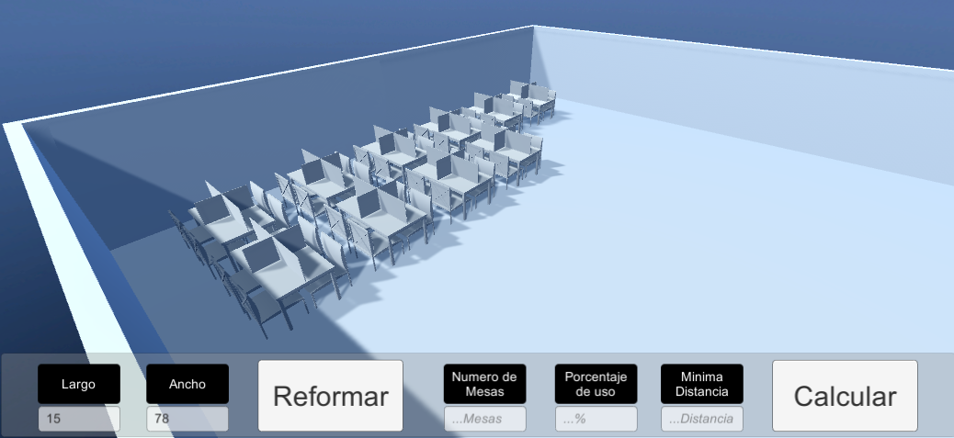
Safe distance optimizer
ARTIFICIAL HACKS

Slide 2
Our jobs
Greg Espinosa – Unity and Client usage
Ricardo Cazares – Server and algorithm
Mario Roque – Algorithm and physical constraints
Javier García – SolidWorks Asset generation and physical constraints

Slide 3


Objectives
Adaptability to any type of building
3D interphase with UNITY
Accessibility on layout
Threshold definitions

Slide 4
Occam's razor
Both in nature, and in sciences, the simplest solution is most likely the right one.

Slide 5
Software Functionality
Unity Interphase
Initial parameters are obtained
Python
The layout is generated, and the tables are placed.
Unity Interphase
The layout of tables is displayed
Movable parameters:
Occupancy threshold
Room size
Number of tables
Minimal safe distance
Fixed parameters:
Selectable walking paths
Selectable room layouts
4 persons per table

Slide 6
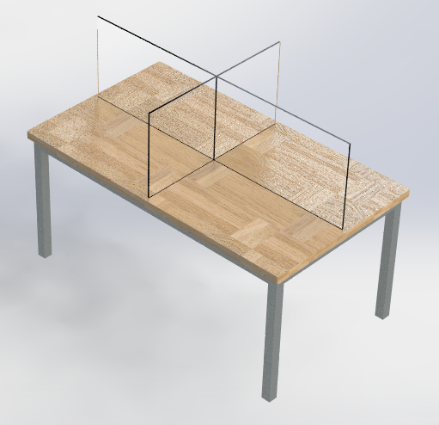
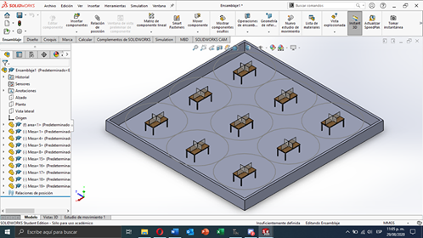
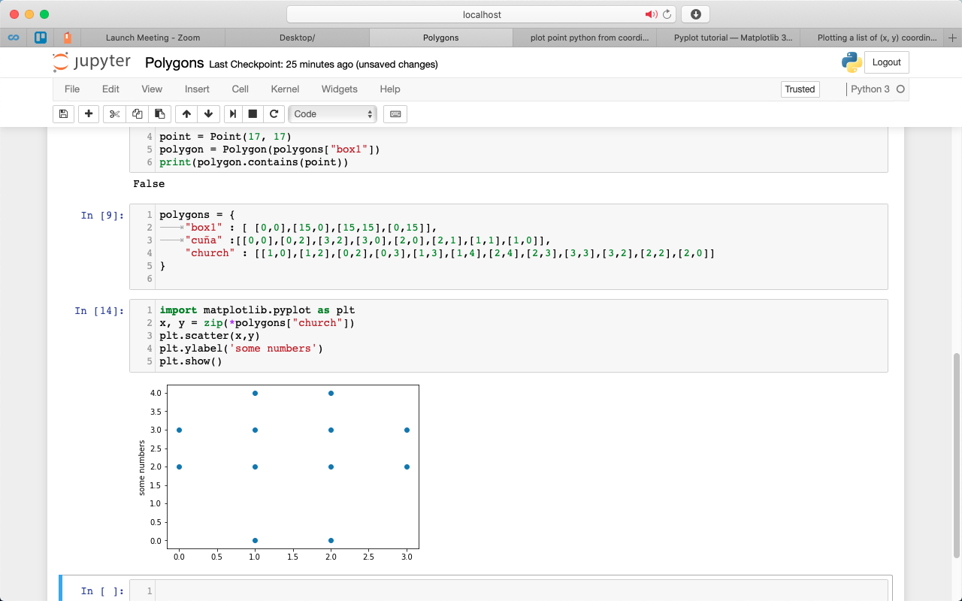
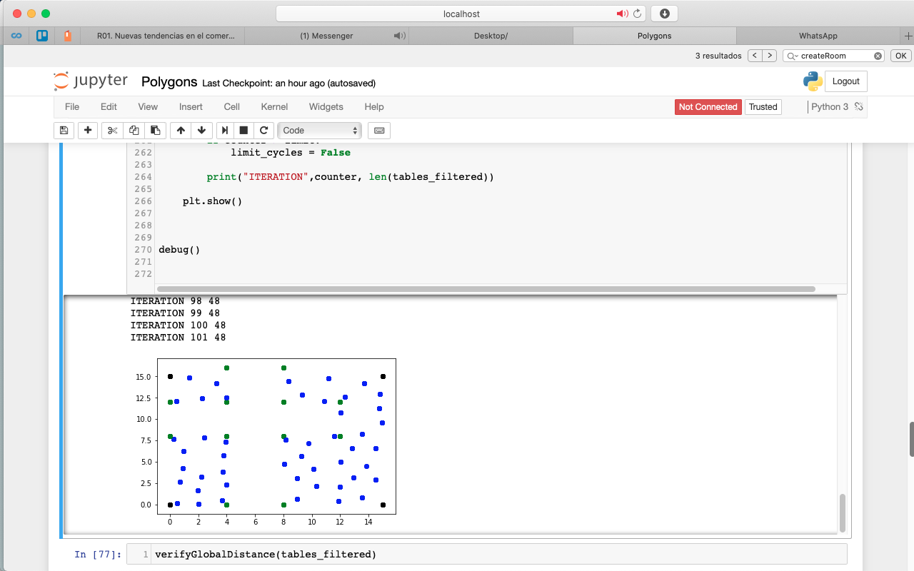
Development process
Asset generation
Room prototyping
Layout generation
Table distribution
3D Representation

Slide 7
Asset generation & Room prototyping
Assets and room prototyping was developed on Solidworks for it to be exported into objects to be received on UNITY

Slide 8
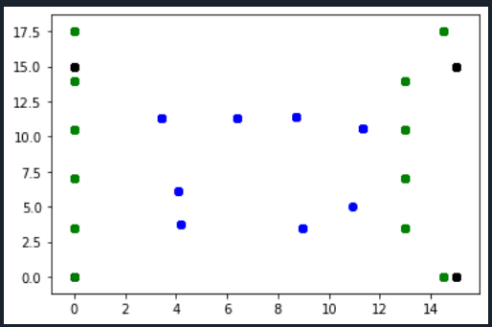

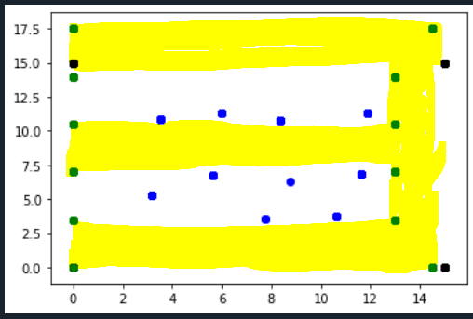
Layout generation & Table distribution
Random distribution allowing for scalability and diverse layout generation:
Prepared to received non squared buildings
Prepared to receive diverse polygons for walking paths
Each corner is a emergency exit

Slide 9
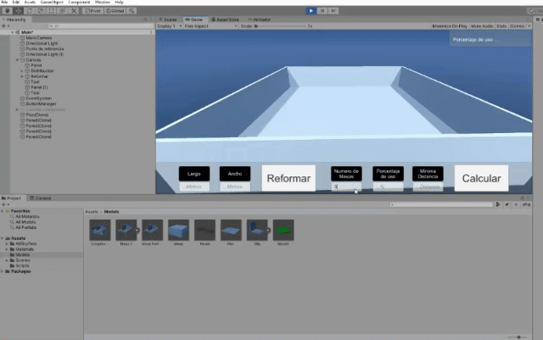
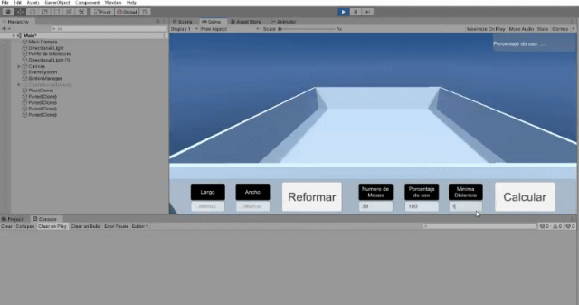
3D Representation
Unity as a dynamic interphase.

Slide 10

Questions

